Slide 1
Using Familysearch.org for Jewish Research
W. Todd Knowles A.G.

Slide 2
What we will discuss today
What is FamilySearch?
Books
Wiki
Digitized Records
Records

Slide 3
What is Familysearch?

Slide 4
What is FamilySearch?
FamilySearch, originally known as the Genealogical Society of Utah, was founded in 1894.
Dedicated to preserving the records of mankind.
Contains almost 6 billion names from all parts of the world.
Over 4800 FamilySearch centers worldwide.

Slide 5
www.familysearch.org

Slide 6
Books
Notes:
Its very important to point out that the books are constantly being added to, and the books her can even be printed off.

Slide 8
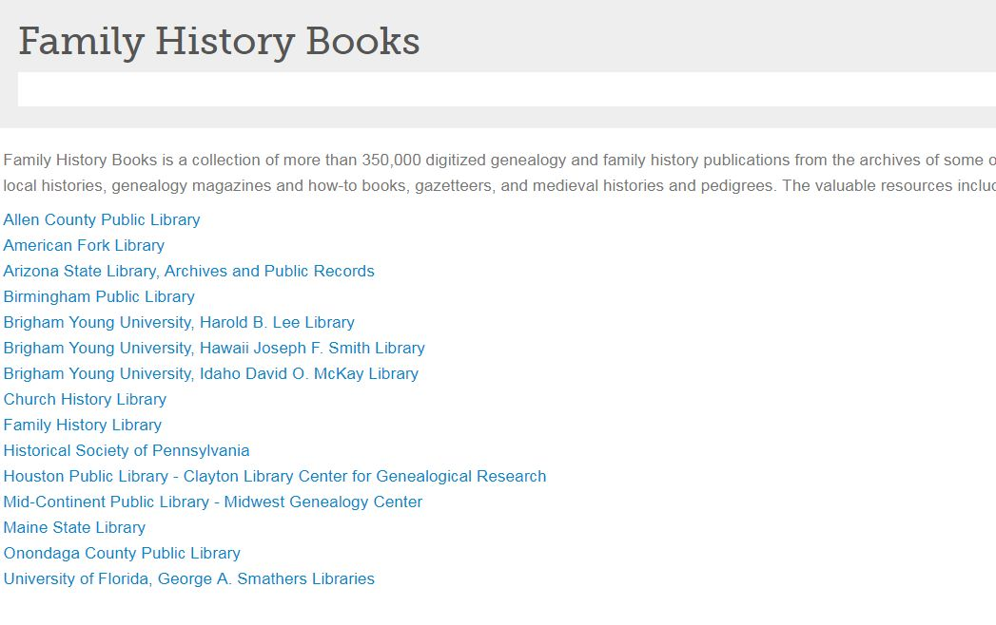
Notes:
These are the archives that are being scanned at this point

Slide 9
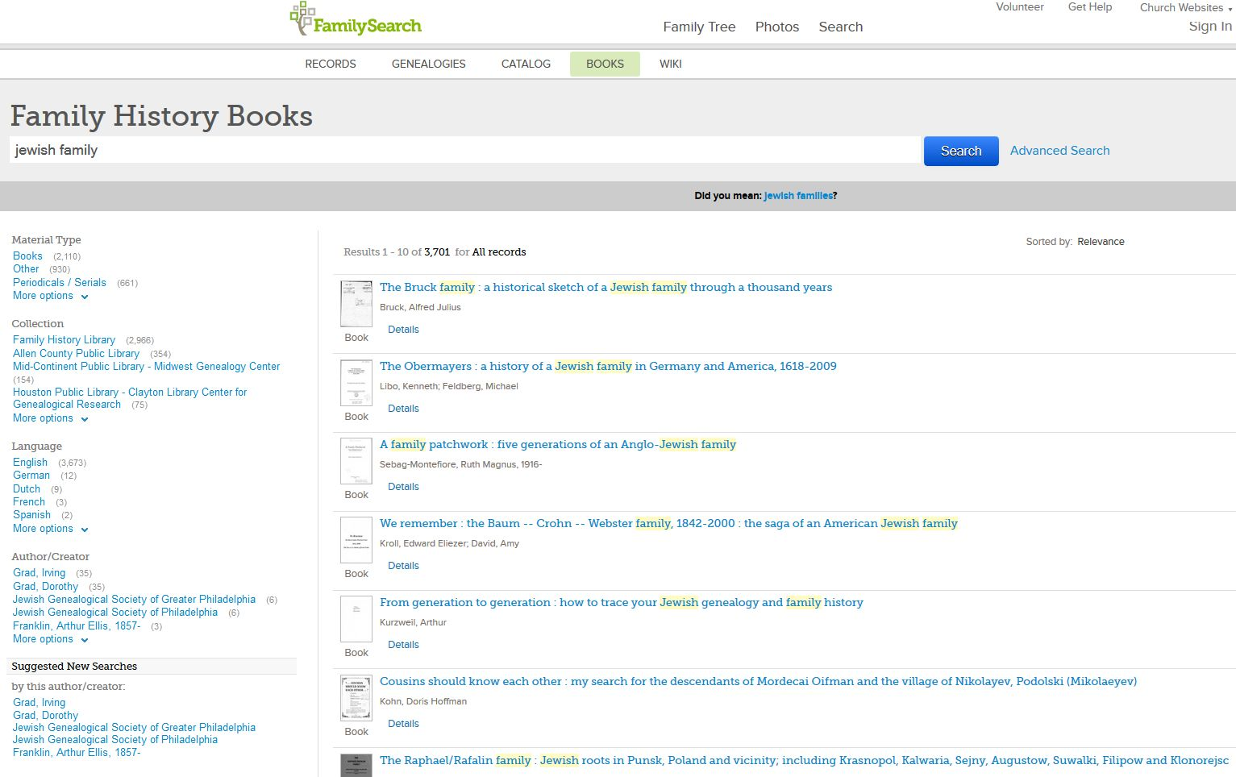
Aug 2017
Notes:
Using the key words Jewish family, brings thousands of hits. By clicking on any entry brings up that book or article. In this case it is the book about the Obermayers.

Slide 10
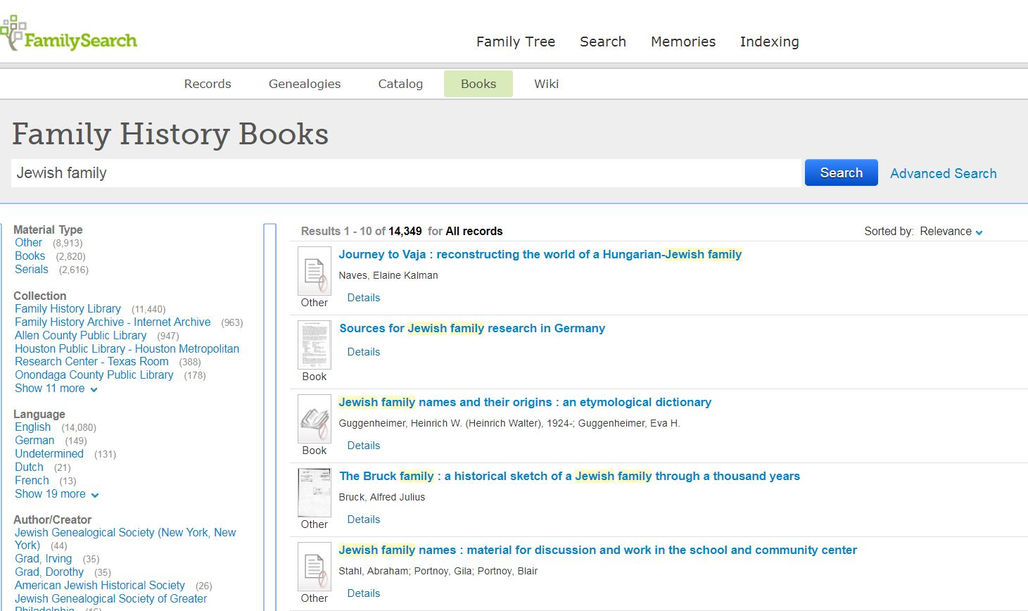
July 2018

Slide 12
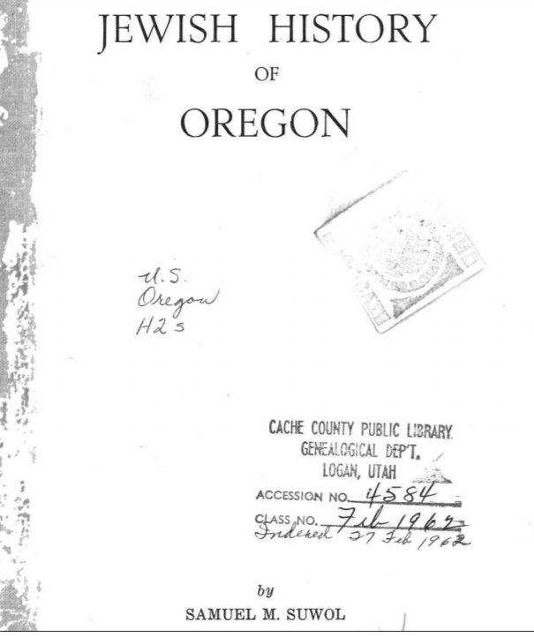

Slide 13
FamilySearch wiki
Notes:
The FamilySearch wiki has over 80,000 articles about every imaginable topic. These articles are contributed by the genealogical community and not by FamilySearch.

Slide 15
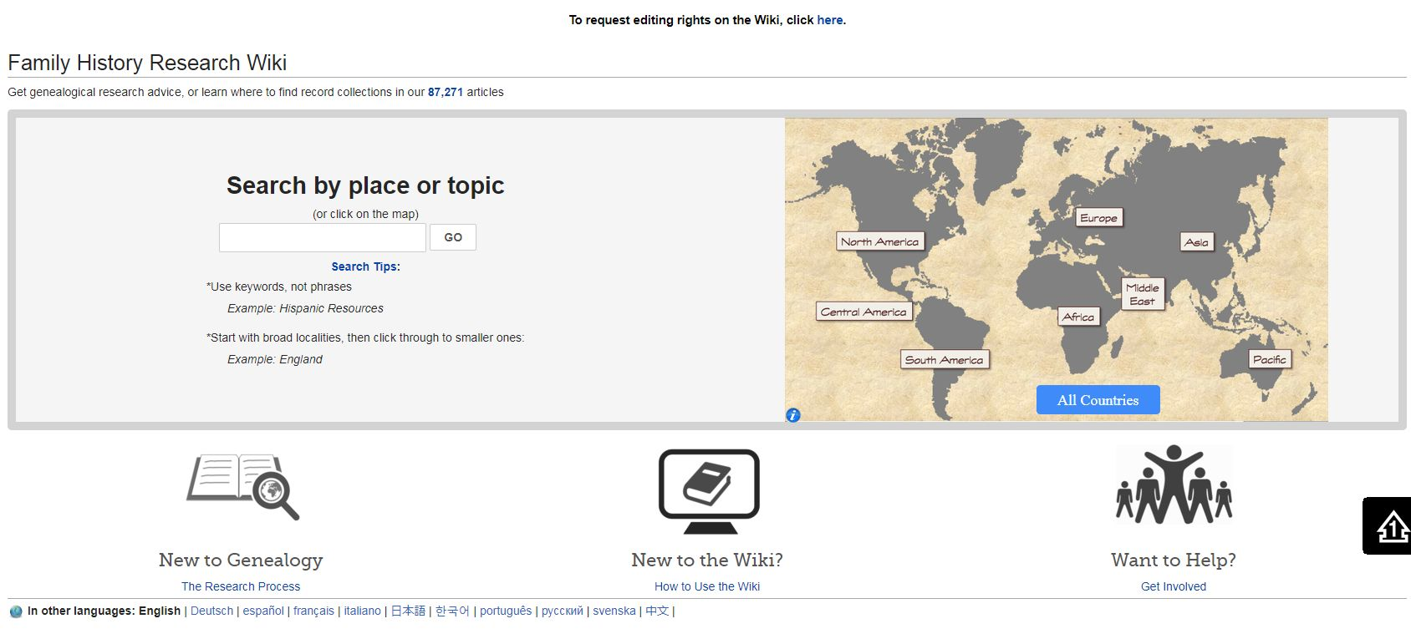

Slide 16
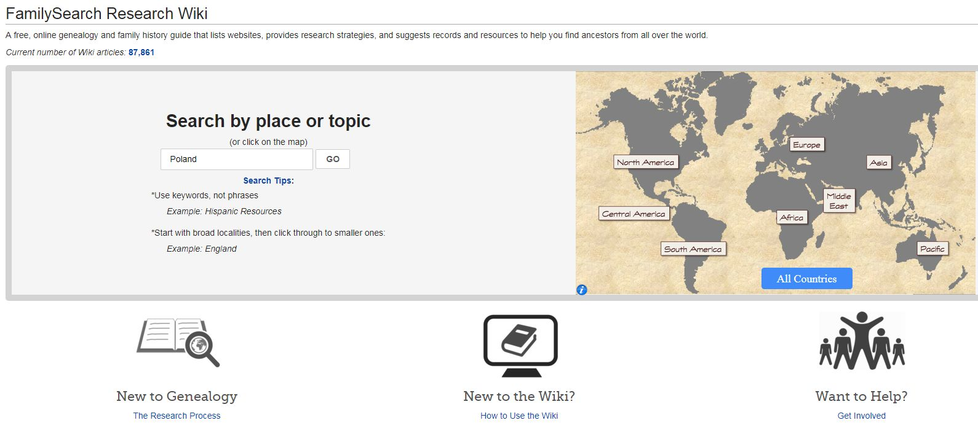
Notes:
In this case I simply did a search for New York records.

Slide 17
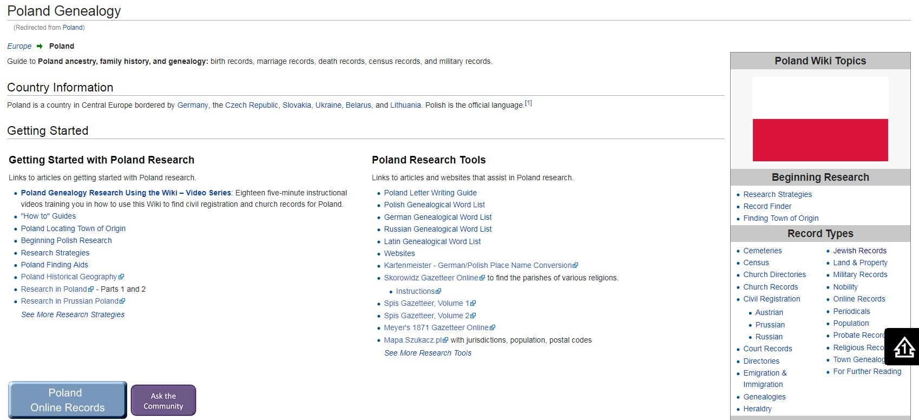
Notes:
This is just a partial list of the articles.

Slide 18
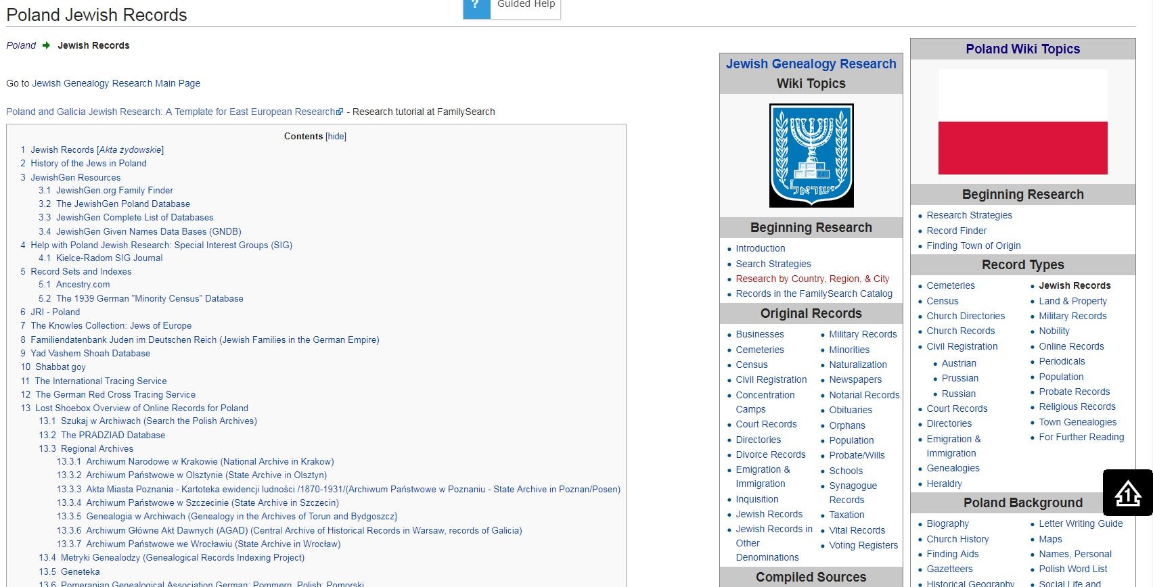
Notes:
Top half of the page

Slide 19
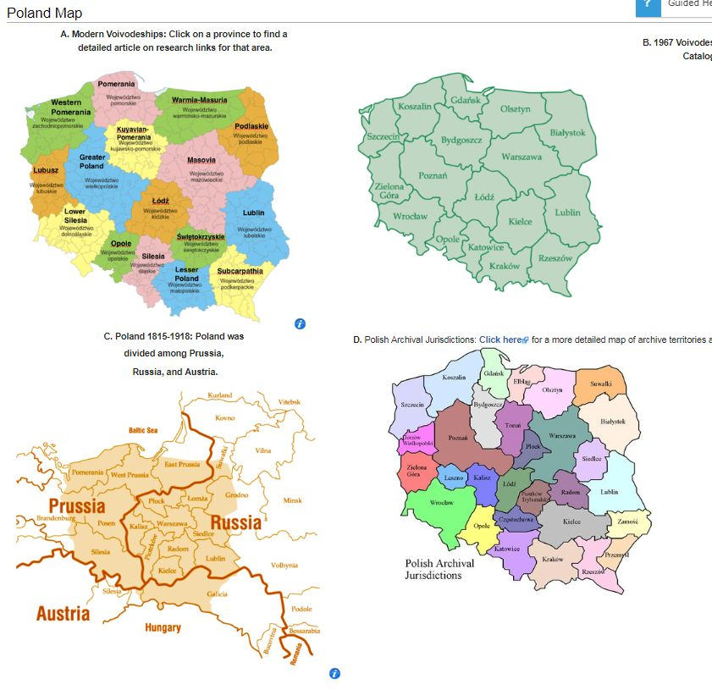

Slide 20
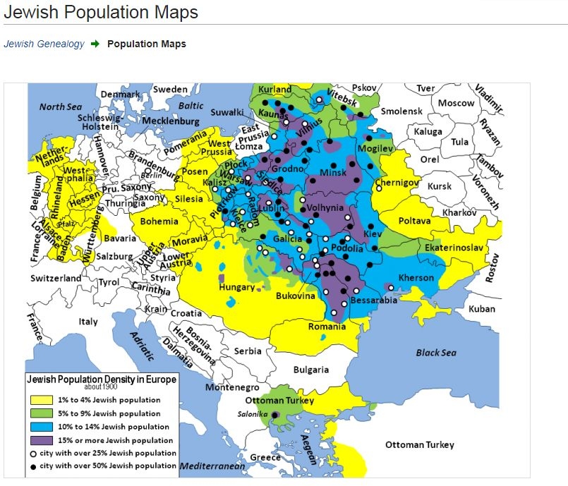

Slide 21
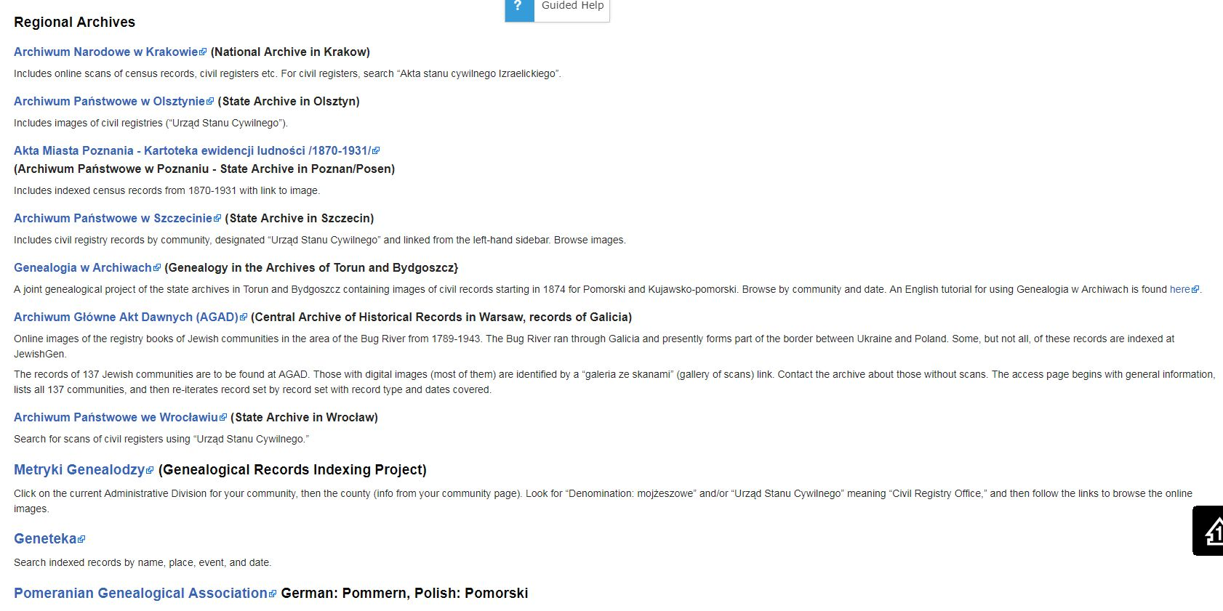

Slide 22
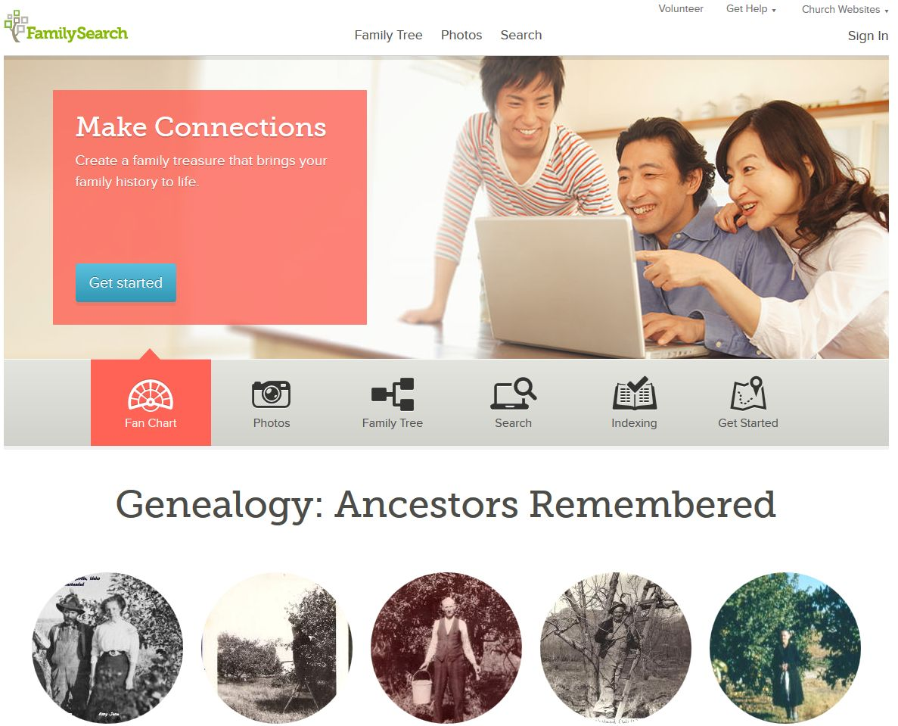

Slide 23
Digitized Records

Slide 24
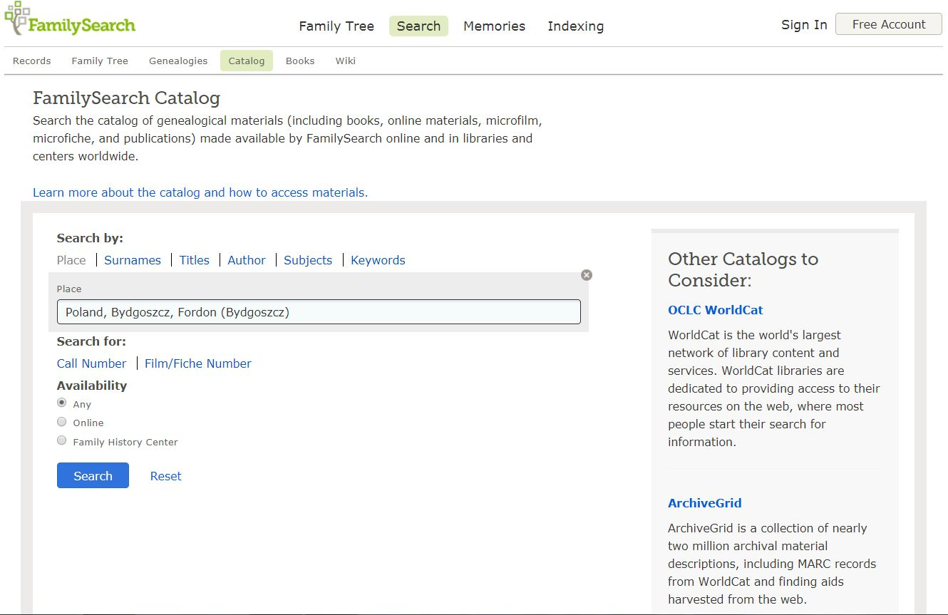

Slide 25
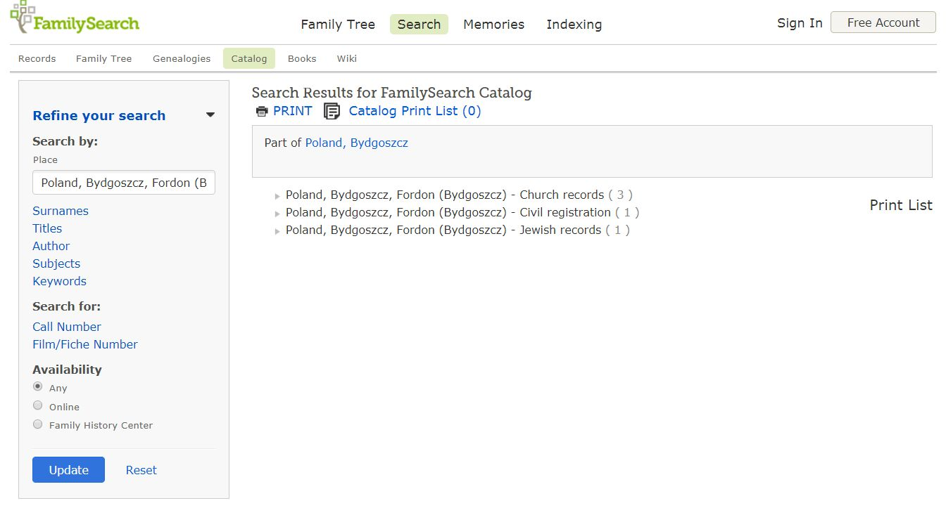

Slide 26
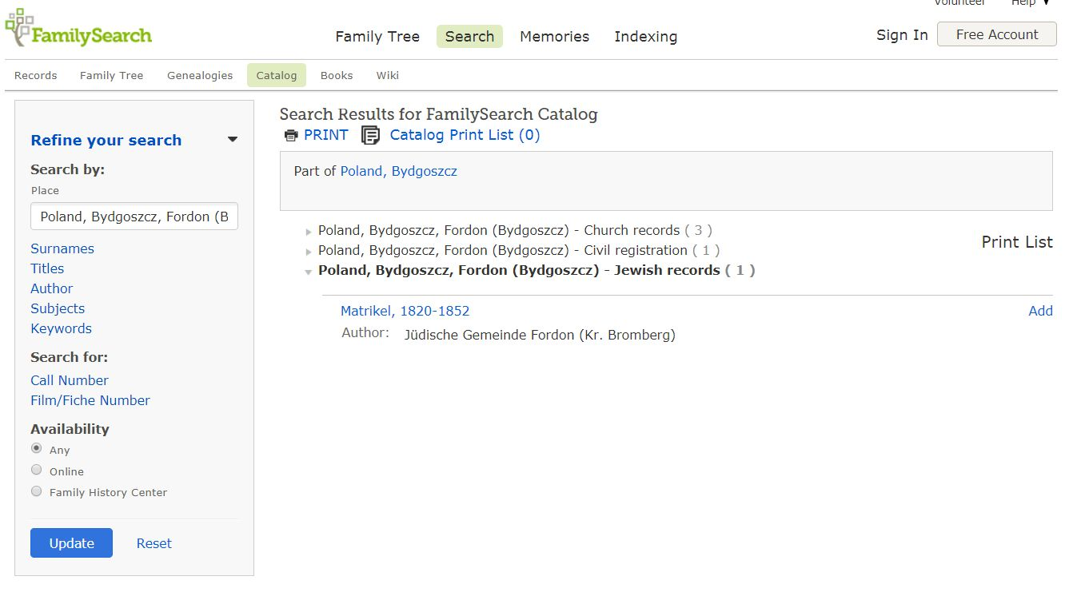

Slide 27
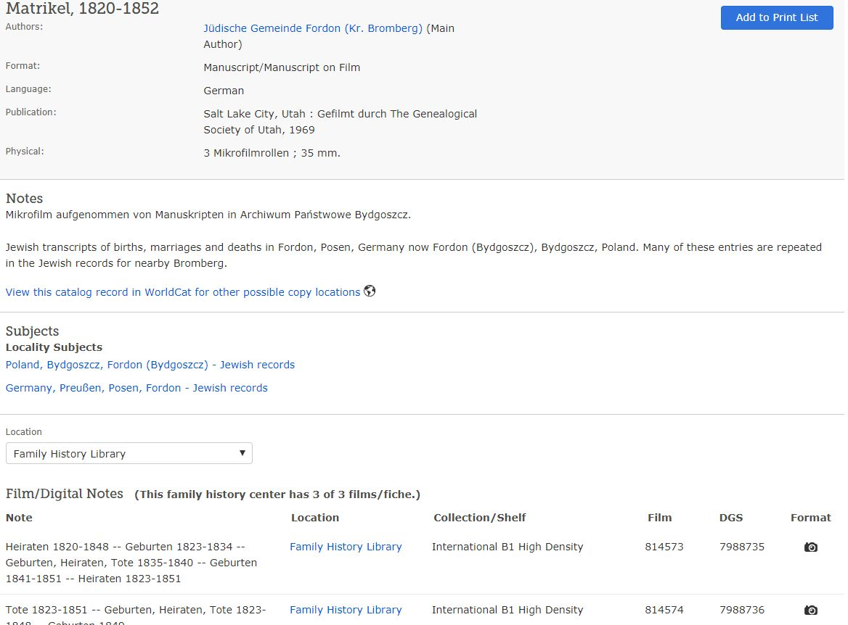

Slide 28
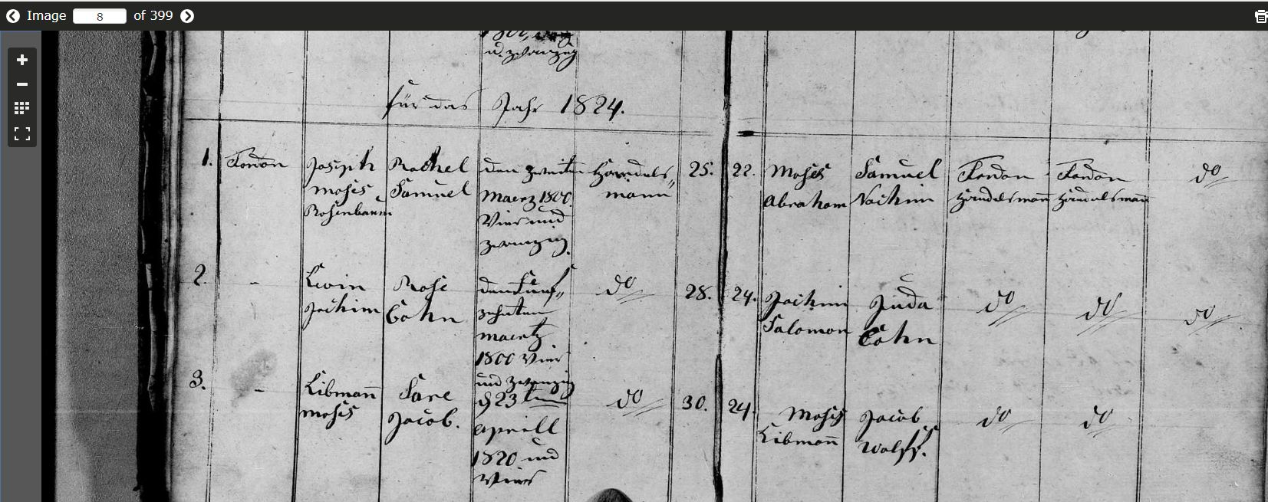

Slide 29
Records
Notes:
I believe that the records section is one of the best sources for Jewish research available.

Slide 30
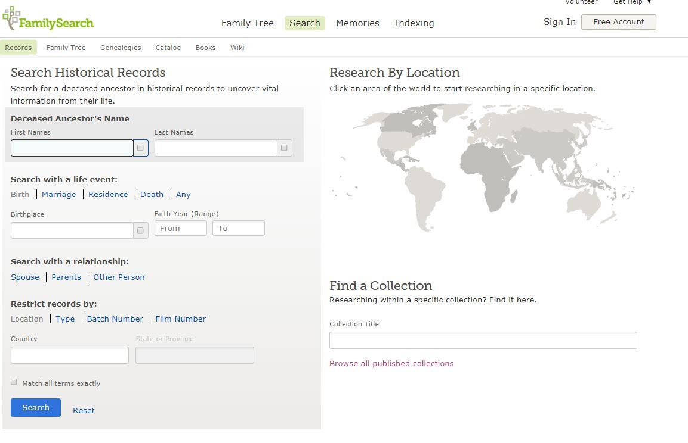

Slide 31
1st way to search

Slide 32
2nd way to search

Slide 33
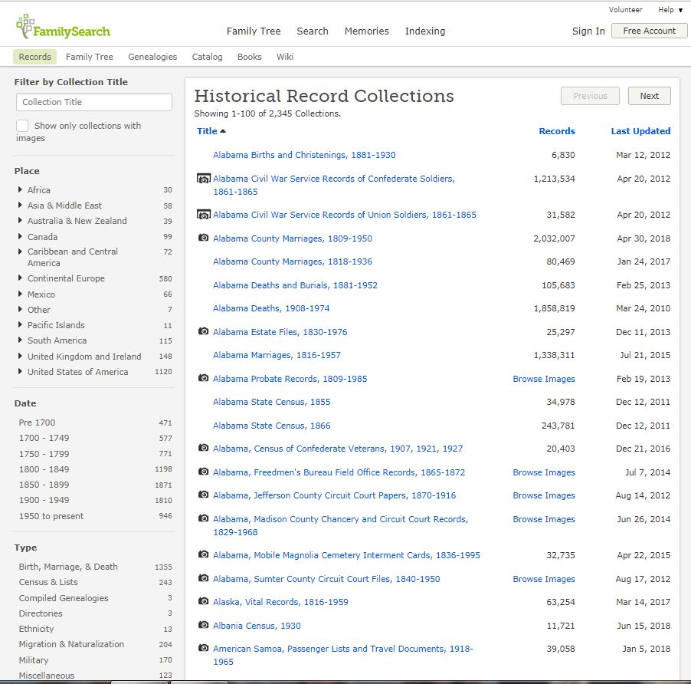

Slide 34
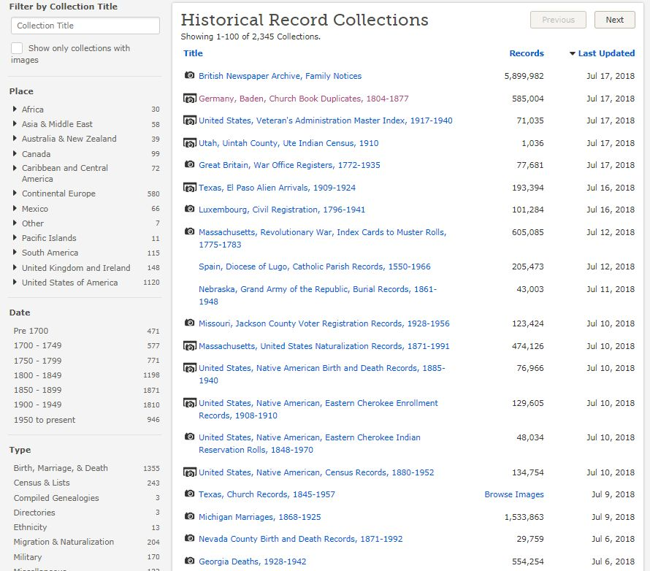

Slide 35
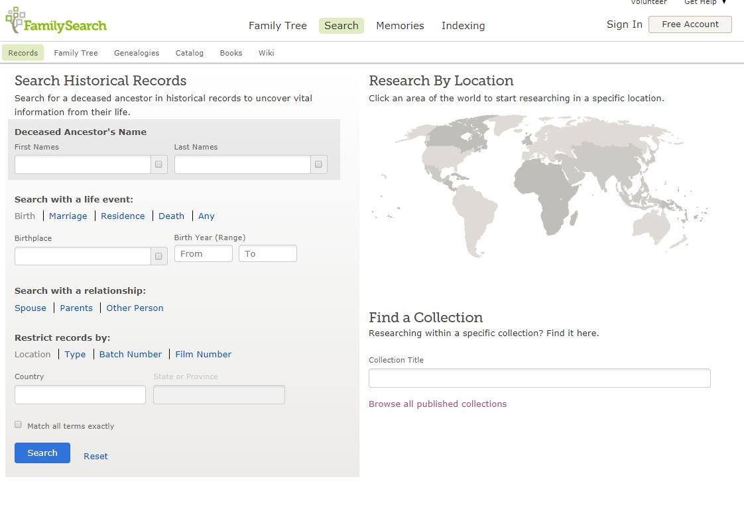

Slide 36
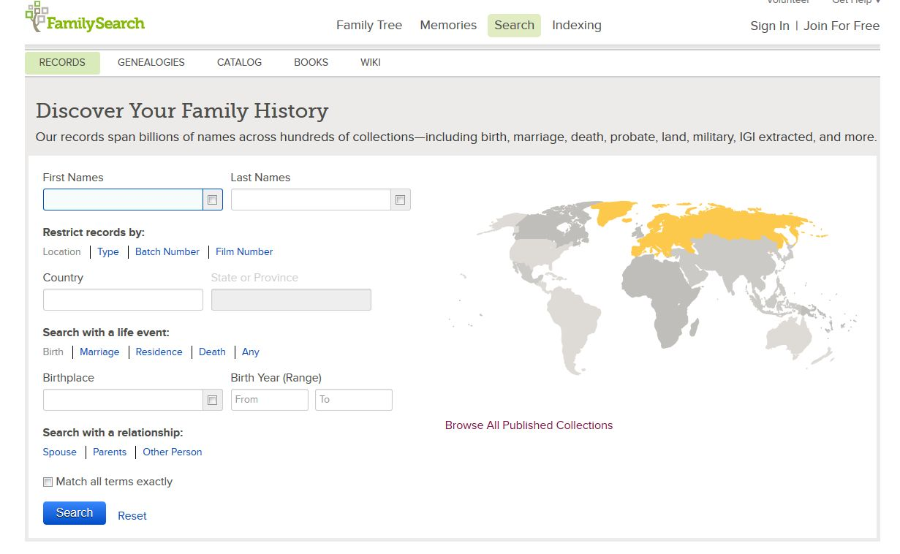
Notes:
As you scroll your mouse over the map, various areas are highlighted. In this case I selected Continental Europe.

Slide 37
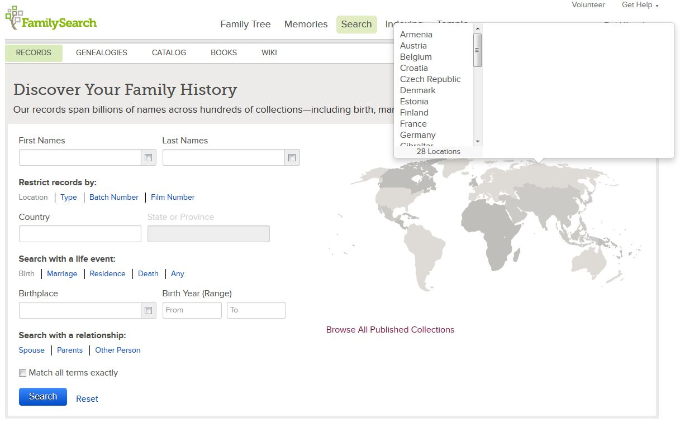
Notes:
After clicking on Coninental Europe, a drop down box appears which shows all the countries available.

Slide 38
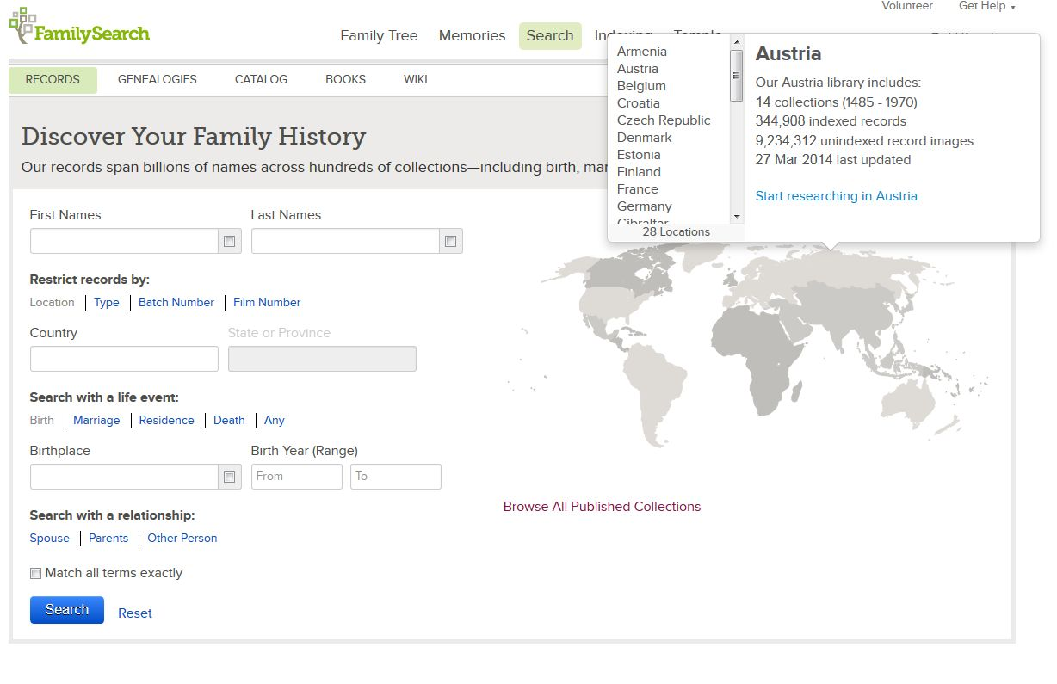
Notes:
I chose Austria, and then the start researching in Austria tab.

Slide 39
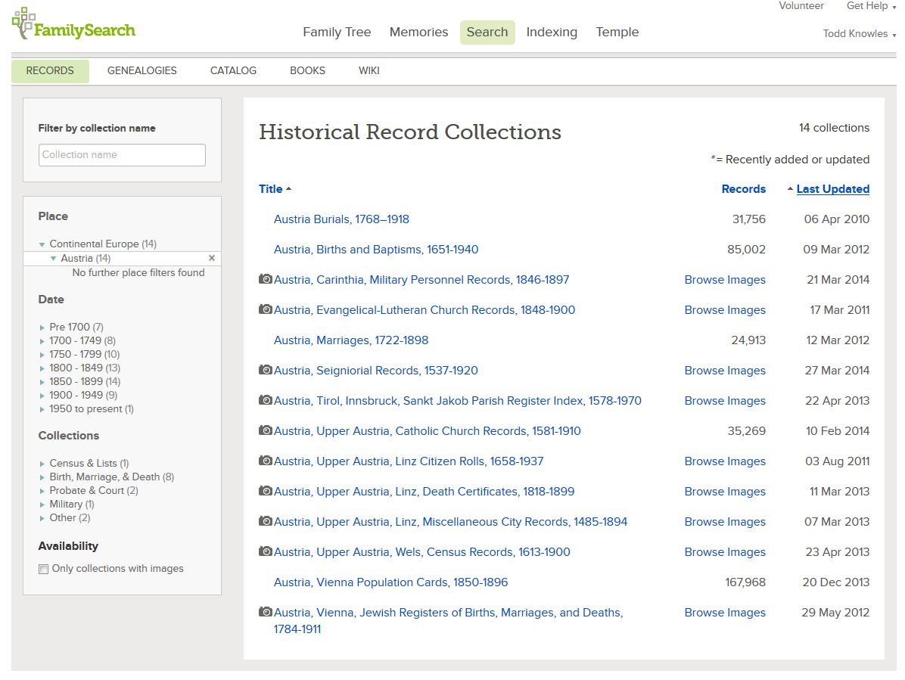
Notes:
It then brings up just the Austrian databases, shown here. Included is the Vienna Jewish registers of Birth, Marriage and Death. 1784-1911

Slide 40
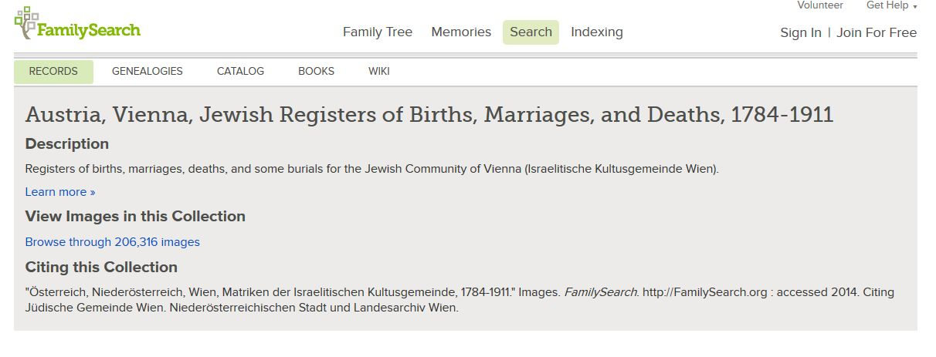
Notes:
As you click non the entry on the previous screen, it shows that you have Over 200,000 images and takes you to a wiki page(shown here) which will give you more info about the record.

Slide 41
Notes:
This entry is then broken down by city or town which enables you to search a very specific area.

Slide 42
Notes:
Also broken down by type of record.

Slide 43
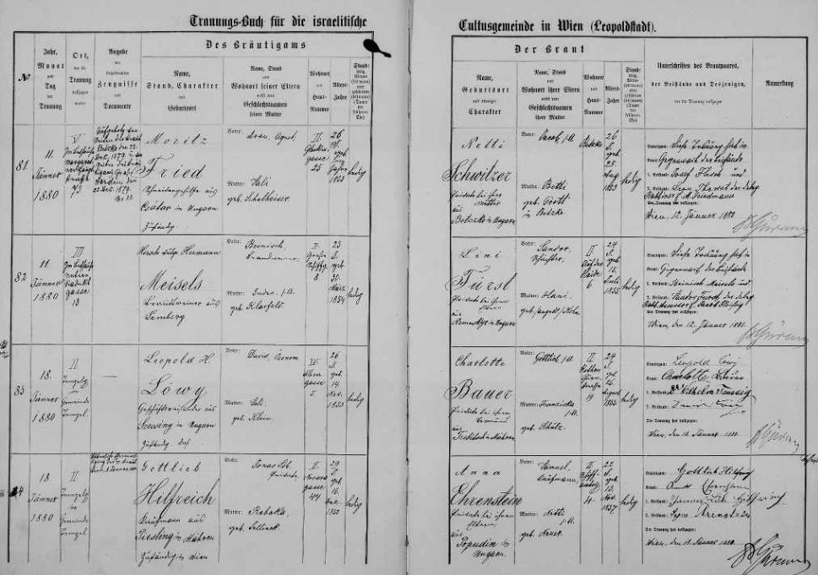
Austria, Vienna, Jewish Registers of Births, Marriages, and Deaths, 1784-1911
Notes:
Finally the actual record.

Slide 44
Making the World a Little Smaller
Notes:
These are some examples of different kinds of records.

Slide 45
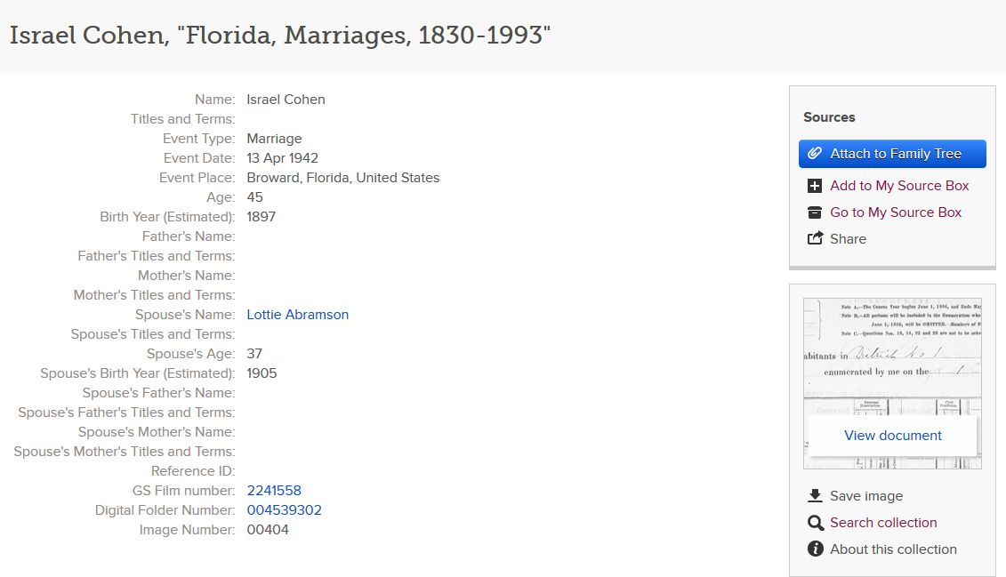
Notes:
Marriage record, this also gives the Family History Library film number where the information came from and by clicking on View document, the original record is shown

Slide 46
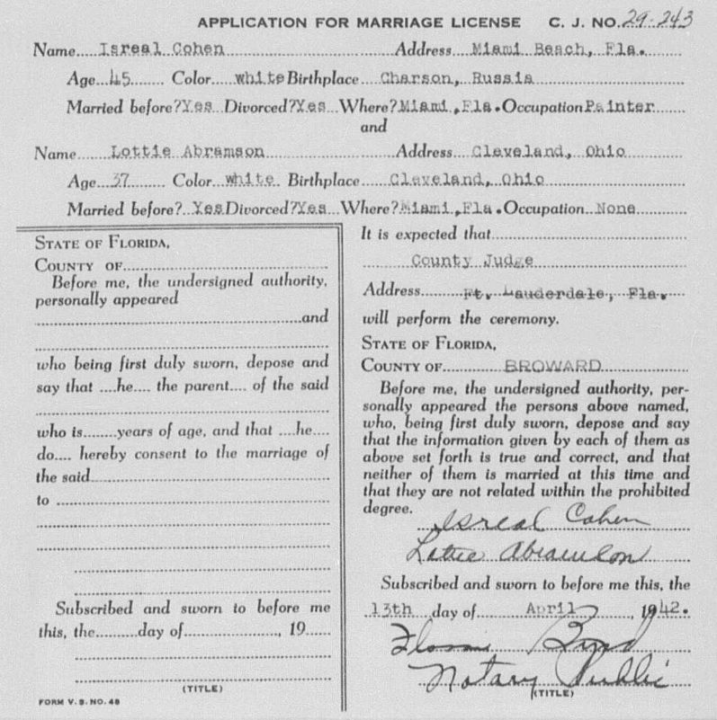
Florida, Marriages 1830- 1993
Notes:
Original record

Slide 47
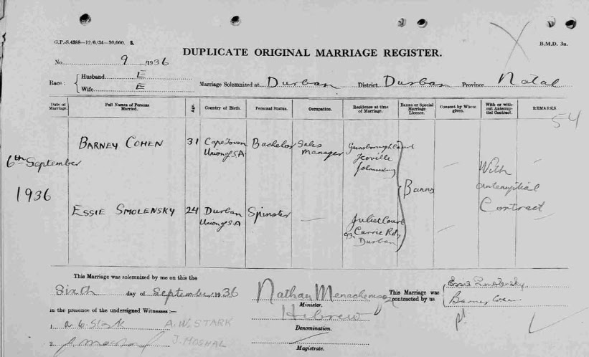
South Africa, Natal Province, Civil Marriages, 1845-1955
Notes:
South African marriage

Slide 48
Massachusetts, Deaths, 1841-1915
27 Feb 1900
Notes:
Mass. Death record

Slide 49
Immigration records
Petitions, filed in Philadelphia, requesting permission for family members to come to America

Slide 50
Canada Passenger Lists, 1881-1922
Notes:
Canadian record where the family is identified as Hebrew

Slide 51
British Newspaper Archive

Slide 52
Hong Kong
China, Cemetery Records, 1820-1983
Notes:
These are all for the year 1958 and its interesting to note that the first three all died in the Shamrock Hotel, so people may want to avoid that place when travelling.

Slide 53
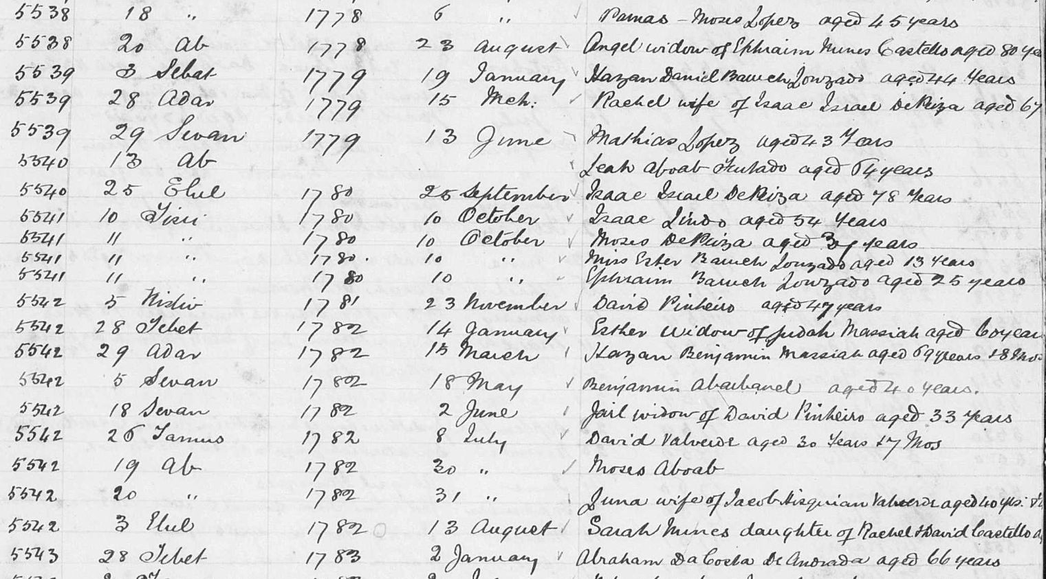
Barbados
Barbados, Church Records, 1637-1887
Notes:
These death records for the Jewish community in Barbados were found within the Church records. They had been recorded there, which shows that all records should be checked as Jewish people will appear in other records. Also there are 4 deaths listed for 10 October 1780. A basic check of some history shows that it was one of the worst hurricanes in history.

Slide 54
10 October 1780
200 mile per hour winds
Estimated 20,000-30,000 dead
Destroyed 40 French ships
Destroyed 19 Dutch ships
Modernhistorian.blogspot.com

Slide 55
Argentina
Argentina National Census, 1869
Notes:
Census record where family is listed as Israelite

Slide 56
Louisiana, New Orleans Passenger Lists, 1820-1945

Slide 57
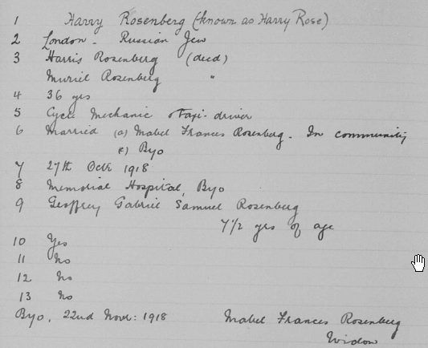
Rhodesia/Zimbabwe
Zimbabwe, Death notices, 1904-1976
Notes:
This record is hard to understand, yet amazing. Line 1 is name including AKA. 2. Where born 3.Father and mother 4. age 5. Occupation 6.Wife 7. Date of death 8. Hospital name 9. Children (if no children, sibilings will be listed here regardless of where in the world they lived).

Slide 58
Jamaica
Jamaica, Civil Birth Registration

Slide 59
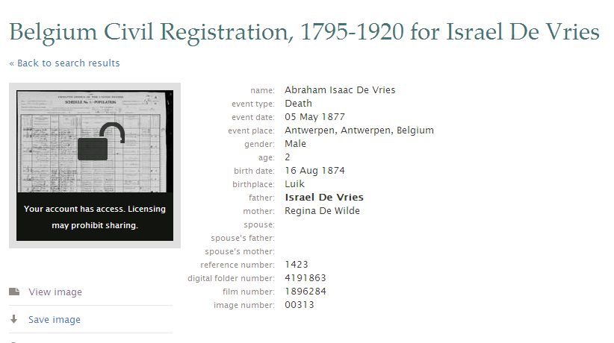
Belgium, Civil Registration

Slide 60
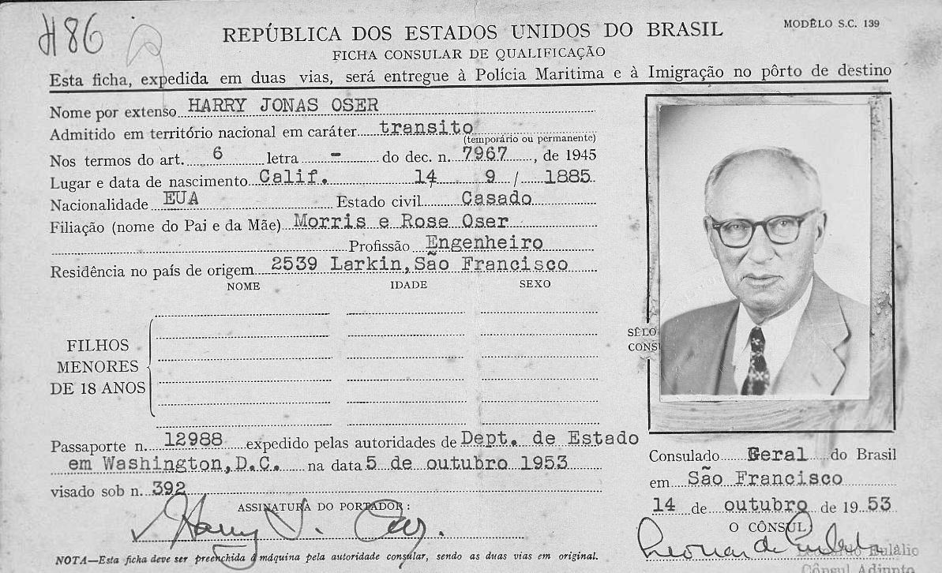
Brazil
Notes:
Photo from previous page.

Slide 61
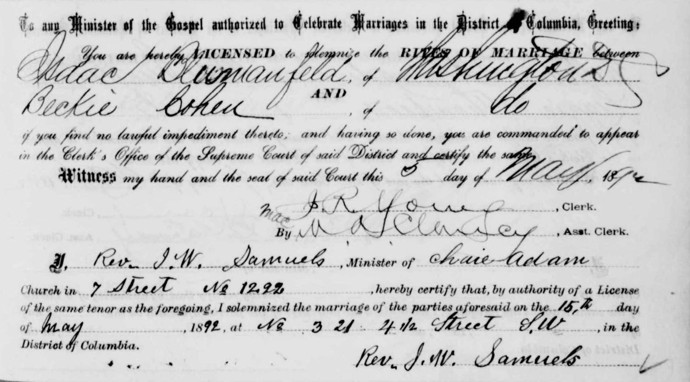
Washington DC Marriages

Slide 62
Italy, Mantova, Jewish Records, 1770-1899

Slide 63
Spain, Province of Cordoba, Municipal records, 1509-1947
1920 Census
Notes:
This is a collection of many records. This first one shows the family in the 1920 census.

Slide 64
1908 Census..adds name Toledano
Notes:
In 1908 the surname Toledano is also included.

Slide 65
1904 Census for wife living with her father
Notes:
And before that the 1904 census gives the wife living with her father.

Slide 66
Knowles Collection
Moses David Rosenbaum

Slide 67
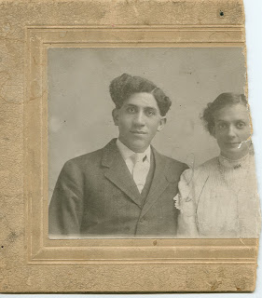

Slide 68
Fordon, Poland Marriage Record

Slide 69
Mordy Collection
Consists of over 155 pedigrees
Records are linked by a numerical code
About 7500 people in the collection
Very hard to research.

Slide 70
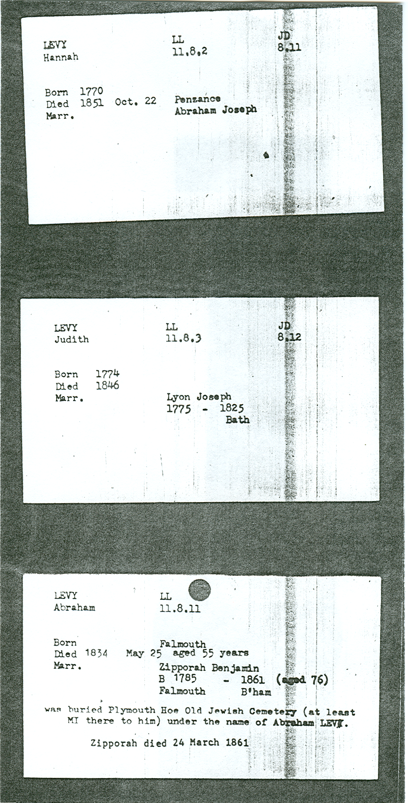
First number (11) is the fathers reference number in the previous generation.
The second number (8) is the generation number.
The third number (11) is the reference number within the generation.
Abraham Levy LL 11.8.11

Slide 71
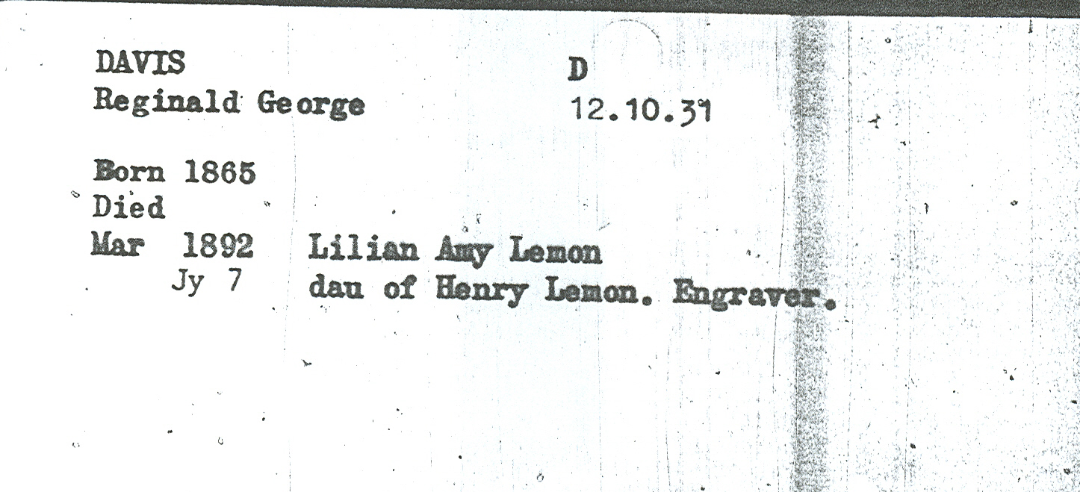
Davis Pedigree D (Lemon)

Slide 72
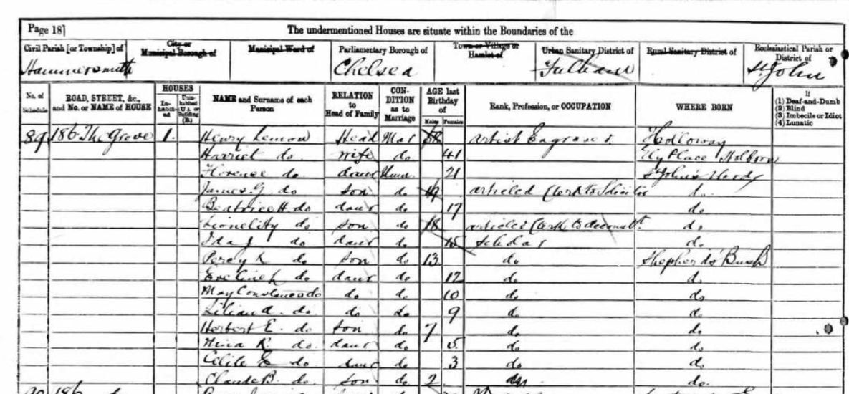
1881 English Census

Slide 73
Gluckstein Family

Slide 74
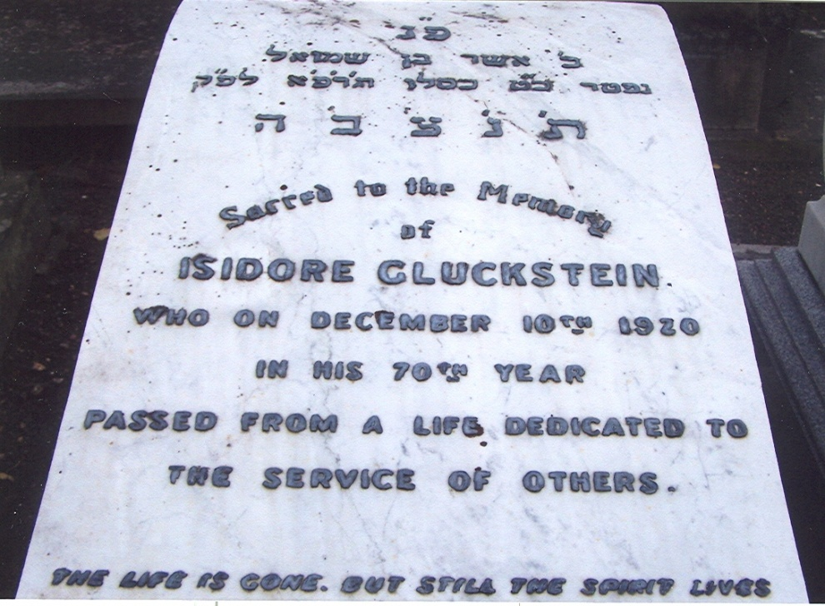
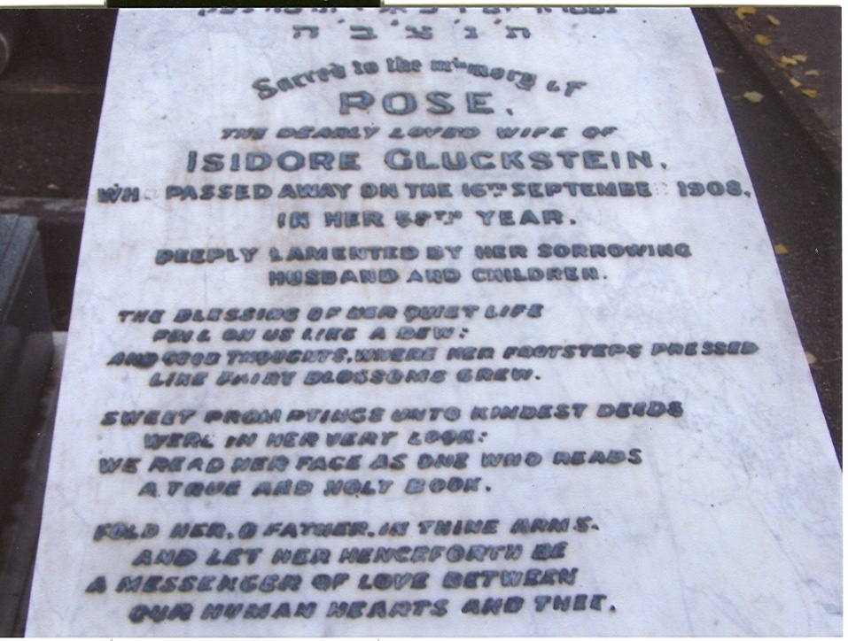
Isidore and Rose Gluckstein
Willesden Cemetery, London

Slide 75
1861 English Census

Slide 76
1871 English Census

Slide 77
1881 British Census

Slide 78
1891 British Census

Slide 79
1901 British Census

Slide 80
1911 British Census

Slide 81
J. Lyons & Co.

Slide 82
Principal Probate Registry

Slide 83
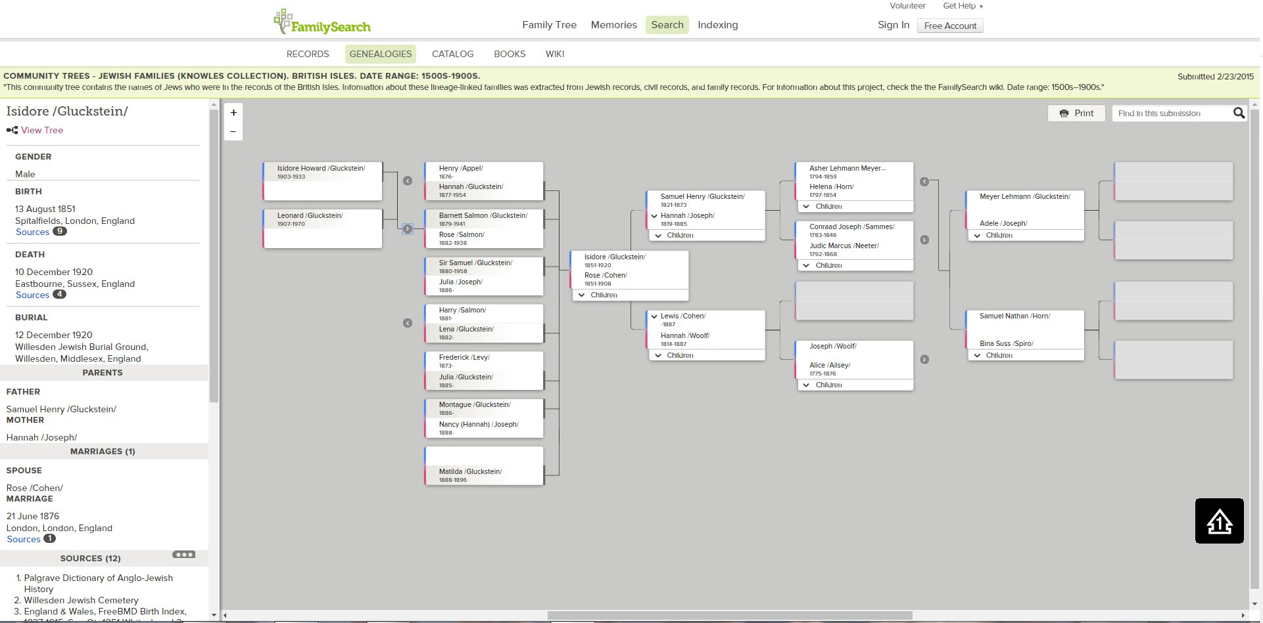
Isidore Gluckstein Pedigree

Slide 84
Knowles Collection
Jews of the British Isles
Jews of Europe
Jews of North America
Jews of Caribbean and South America
Jews of South Pacific
Jews of Africa, The Orient, and The Middle East
Melbourne, Australia

Slide 85
Knowles Collection
Contains over 1.4 million people
Over 2500 different sources
From 200 different countries
Linked as families
Name searchable
Free

Slide 87
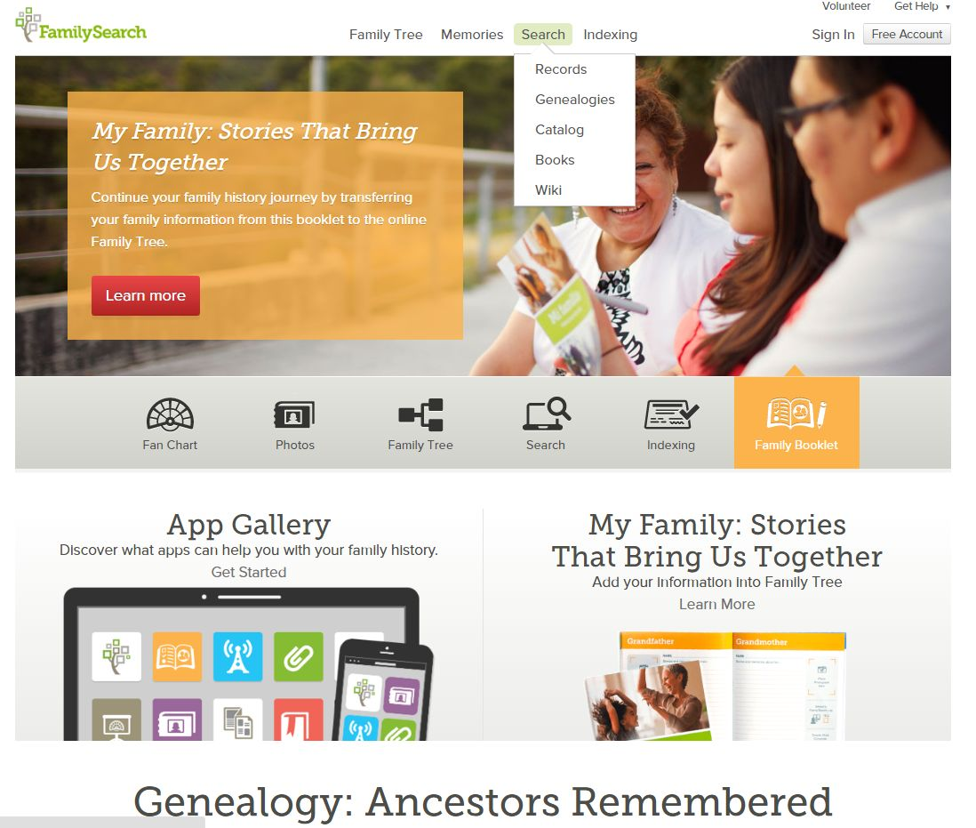

Slide 88
Accessing The Knowles Collection

Slide 89
Knowlescollection.blogspot.com

Slide 90
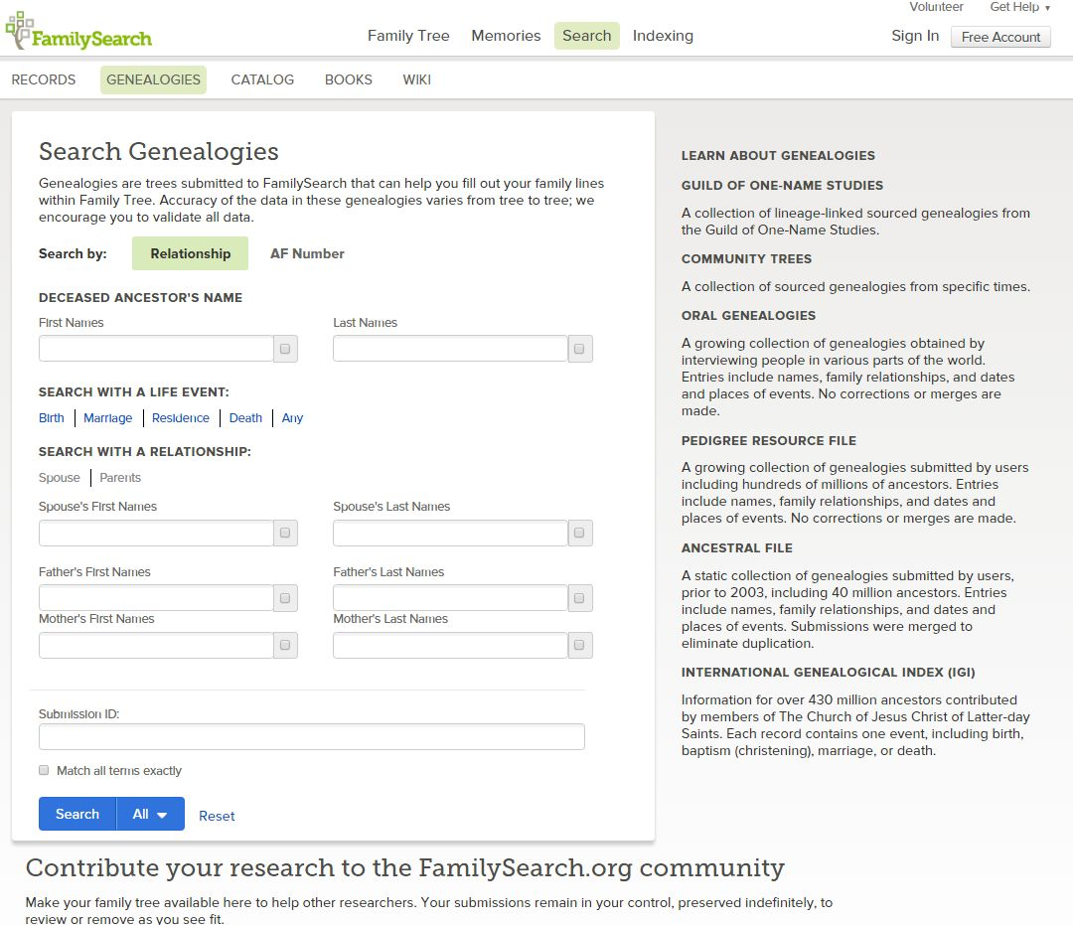

Slide 91
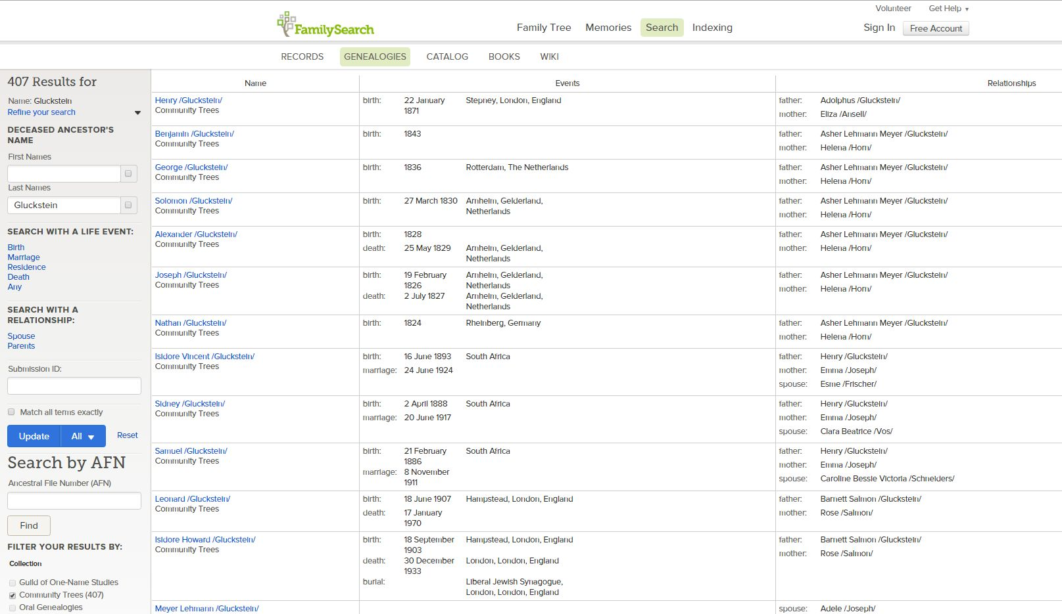

Slide 92
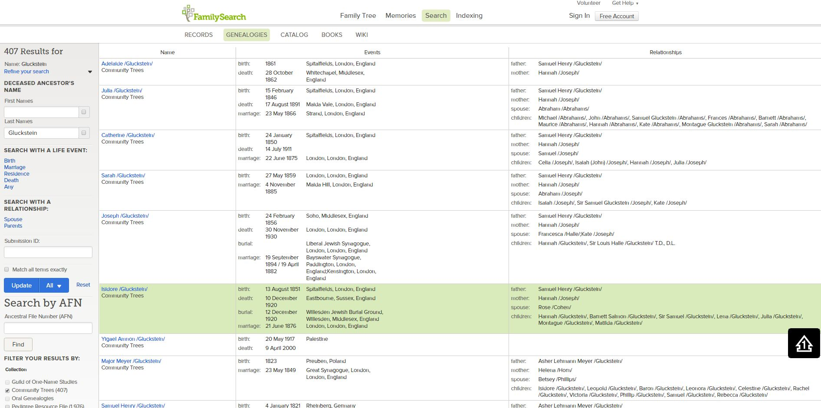

Slide 94
knowleswt@familysearch.org knowlescollection.blogspot.com

